Slide 1
New IT Frontiers: Cloud, Mobile, Social, IOT
IT dynamics are changing the way we communicate, work, and live
These disruptive new IT frontiers have significant security consequences

Slide 2
New IT Frontiers: Cloud, Mobile, Social, IOT
Changing Face Of IT
Cloud
Mobile
Social
IOT

Slide 3
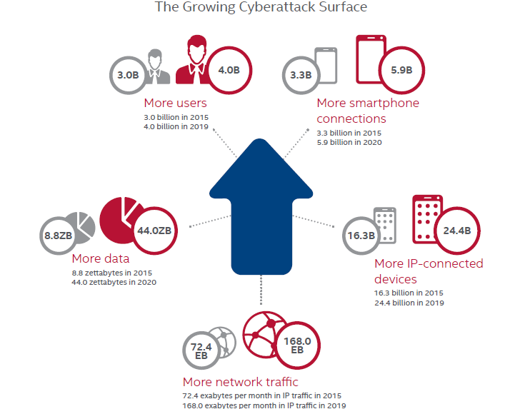
New IT Frontiers: Cloud, Mobile, Social, IOT
https://www.mcafee.com/us/resources/reports/rp-threats-predictions-2016.pdf

Slide 4
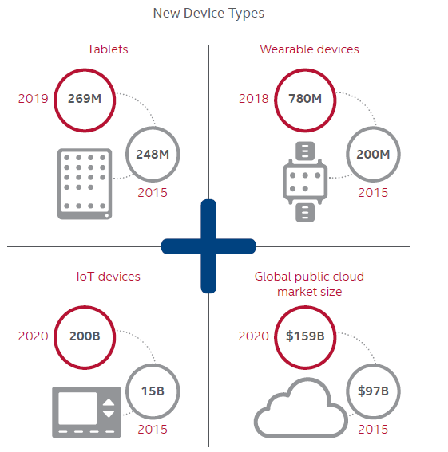
New IT Frontiers: Cloud, Mobile, Social, IOT
https://www.mcafee.com/us/resources/reports/rp-threats-predictions-2016.pdf

Slide 5
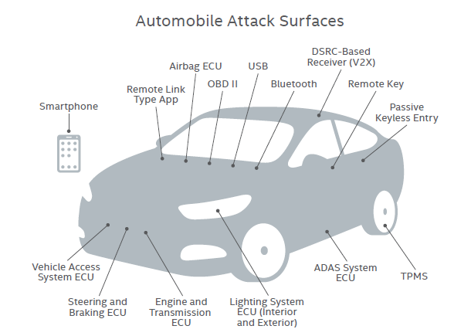
New IT Frontiers: Cloud, Mobile, Social, IOT
https://www.mcafee.com/us/resources/reports/rp-threats-predictions-2016.pdf

Slide 6
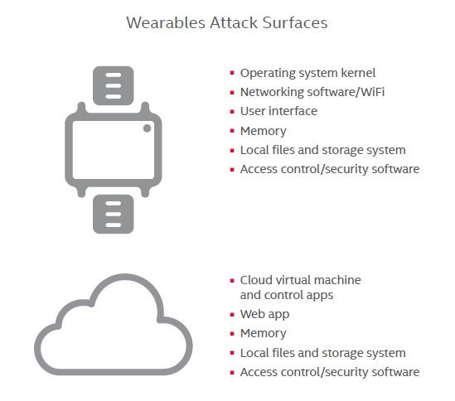
New IT Frontiers: Cloud, Mobile, Social, IOT
https://www.mcafee.com/us/resources/reports/rp-threats-predictions-2016.pdf

Slide 7
New IT Frontiers: Cloud, Mobile, Social, IOT
For cloud, mobile, and IOT security guidance, checklists, and other details visit:
www.cloudsecurityalliance.org
www.owasp.org

Slide 8
New IT Frontiers: Cloud, Mobile, Social, IOT
Useful URLs:
https://www.owasp.org/index.php/OWASP_Mobile_Security_Project
https://www.owasp.org/index.php/OWASP_Internet_of_Things_Project
https://downloads.cloudsecurityalliance.org/assets/research/security-guidance/csaguide.v3.0.pdf
https://downloads.cloudsecurityalliance.org/initiatives/mobile/Mobile_Guidance_v1.pdf
https://downloads.cloudsecurityalliance.org/assets/research/mobile/MAST_White_Paper.pdf
https://downloads.cloudsecurityalliance.org/whitepapers/Security_Guidance_for_Early_Adopters_of_the_Internet_of_Things.pdf
https://downloads.cloudsecurityalliance.org/assets/research/internet-of-things/connected-vehicle-security.pdf

